Slide 1
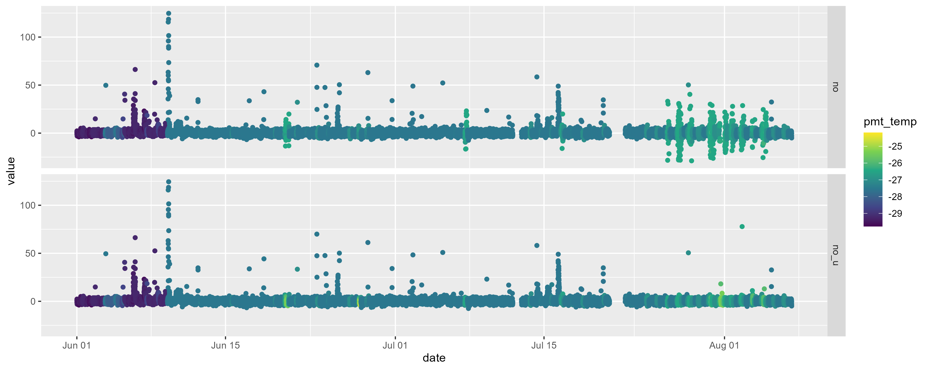
NO filtered vs unfiltered
Notes:
Looking at the final NO data if it’s processed with code removing data when the PMT temperature is above -27 degrees and code that doesn’t consider the PMT temperature at all. With all the fluctuations we are currently seeing in the temperature, I wasn’t sure what to set the threshold for data removal at, so checking what the data looks like.
I think specifically I should be checking what the background counts look like and if they vary massively, but reassuring to see that the data where no filtering based on temperature has been done the baseline looks the same really as before

Slide 2
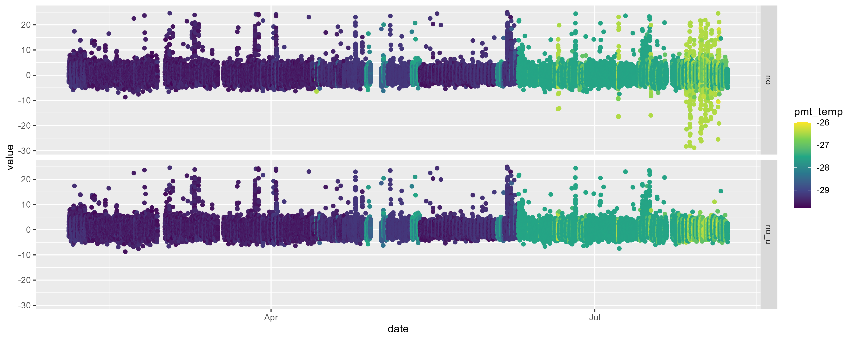
Above but zoomed in
Notes:
Filtered to show only data below 20 ppt

Slide 3
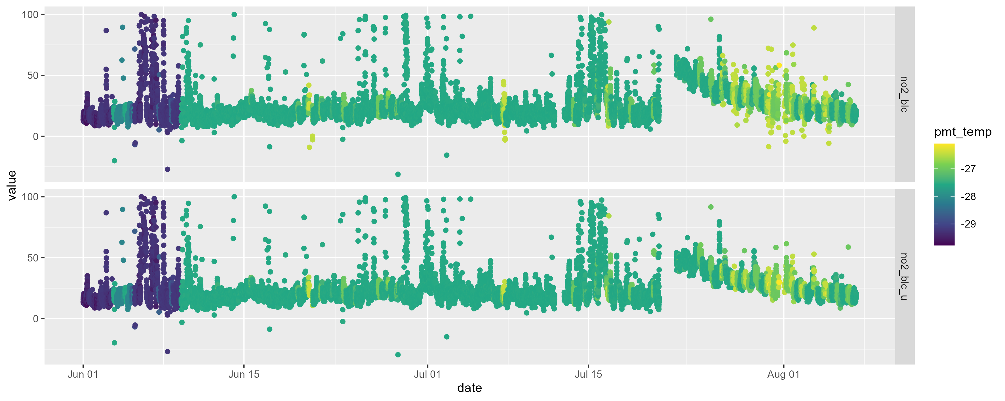
With NO₂ BLC
Notes:
There was an issue when the instrument was restarted, with NO₂ concentrations slowly returning back down to the usual average, but in terms of it being more noisy when there is no filter on the PMT temperature, I don’t think that’s the case
Filtered to show only data below 100 ppt

Slide 4
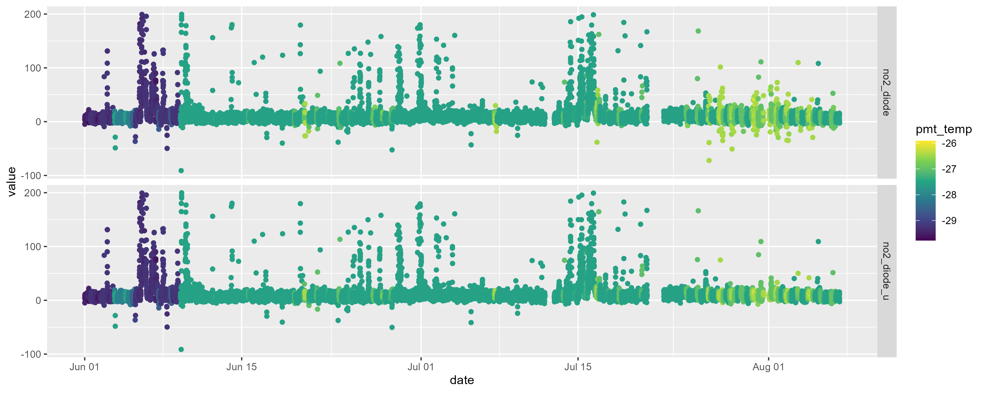
With NO₂ diodes
Notes:
Filtered to show only data below 200 ppt

Slide 5
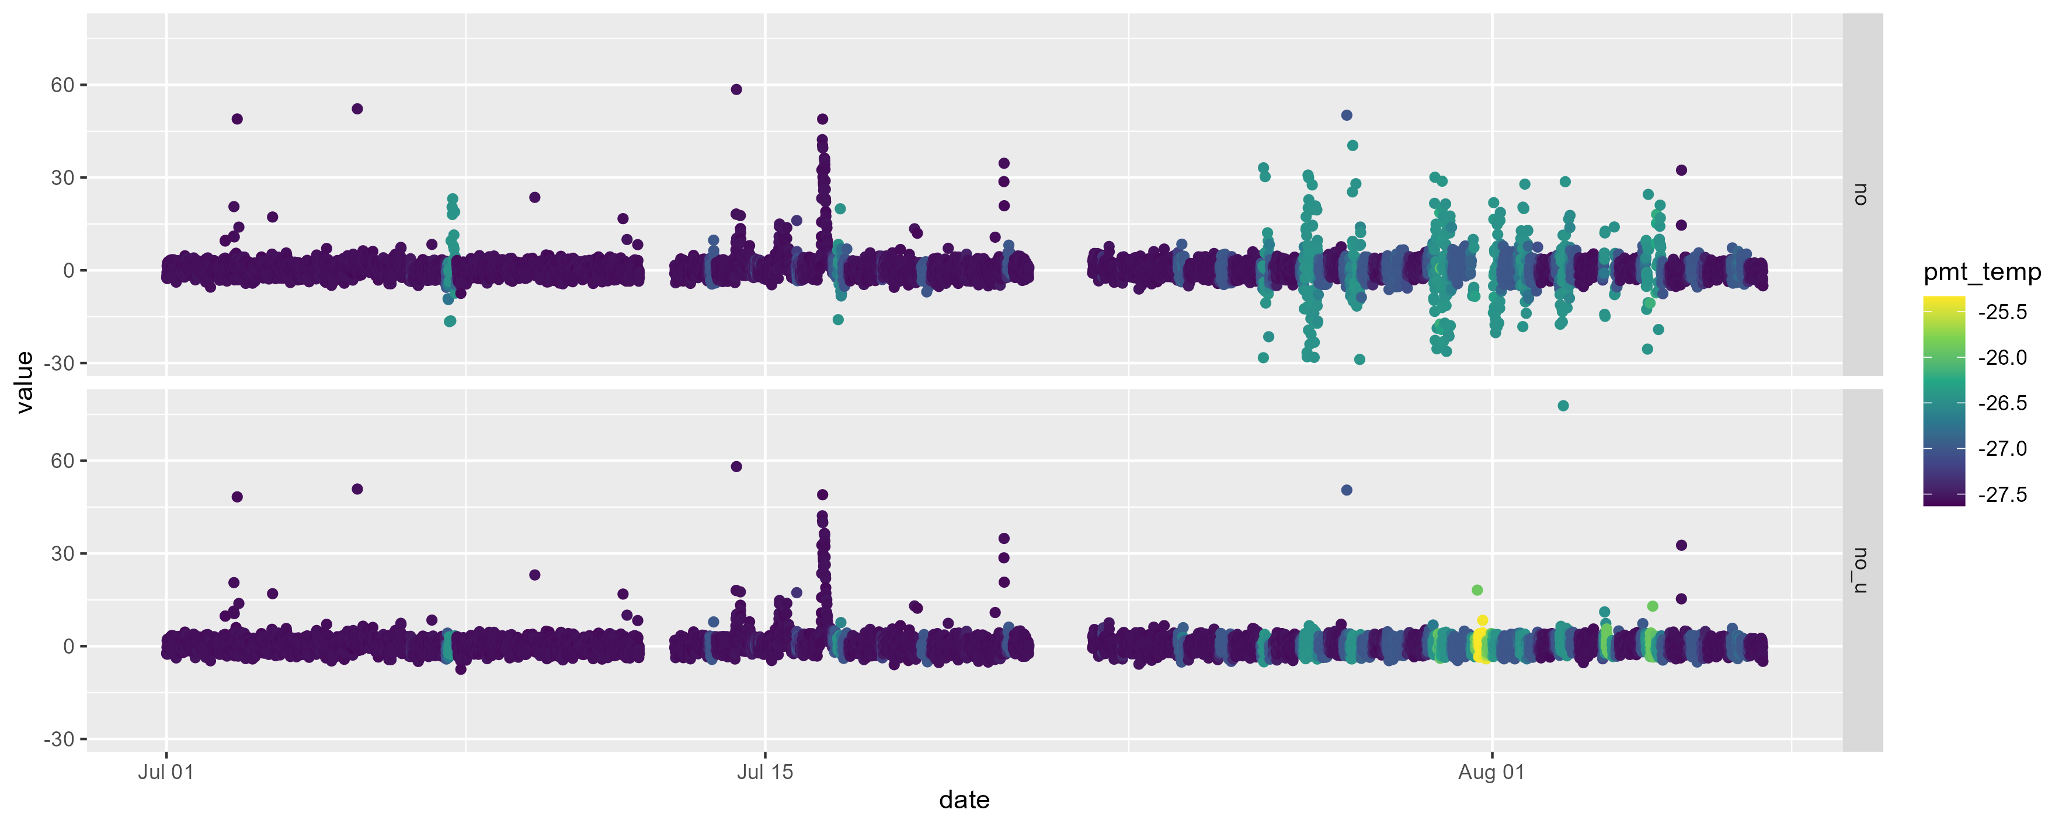
NO in July and early August

Slide 6
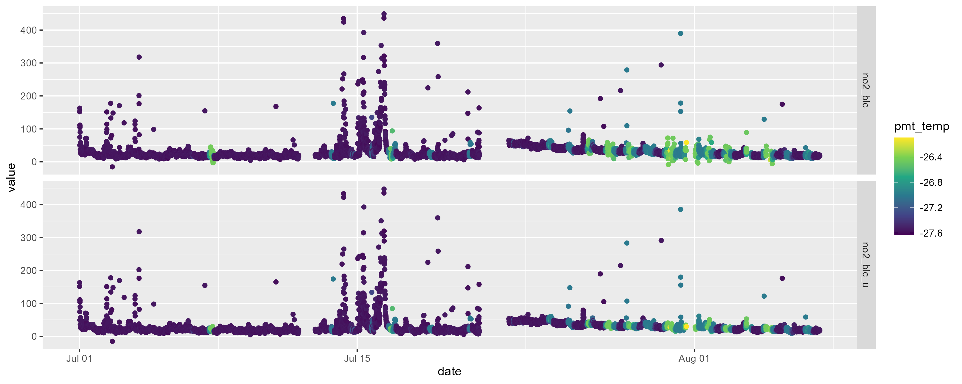
NO₂ BLC in July and early August
Notes:
Filtered to show only data below 500 ppt

Slide 7
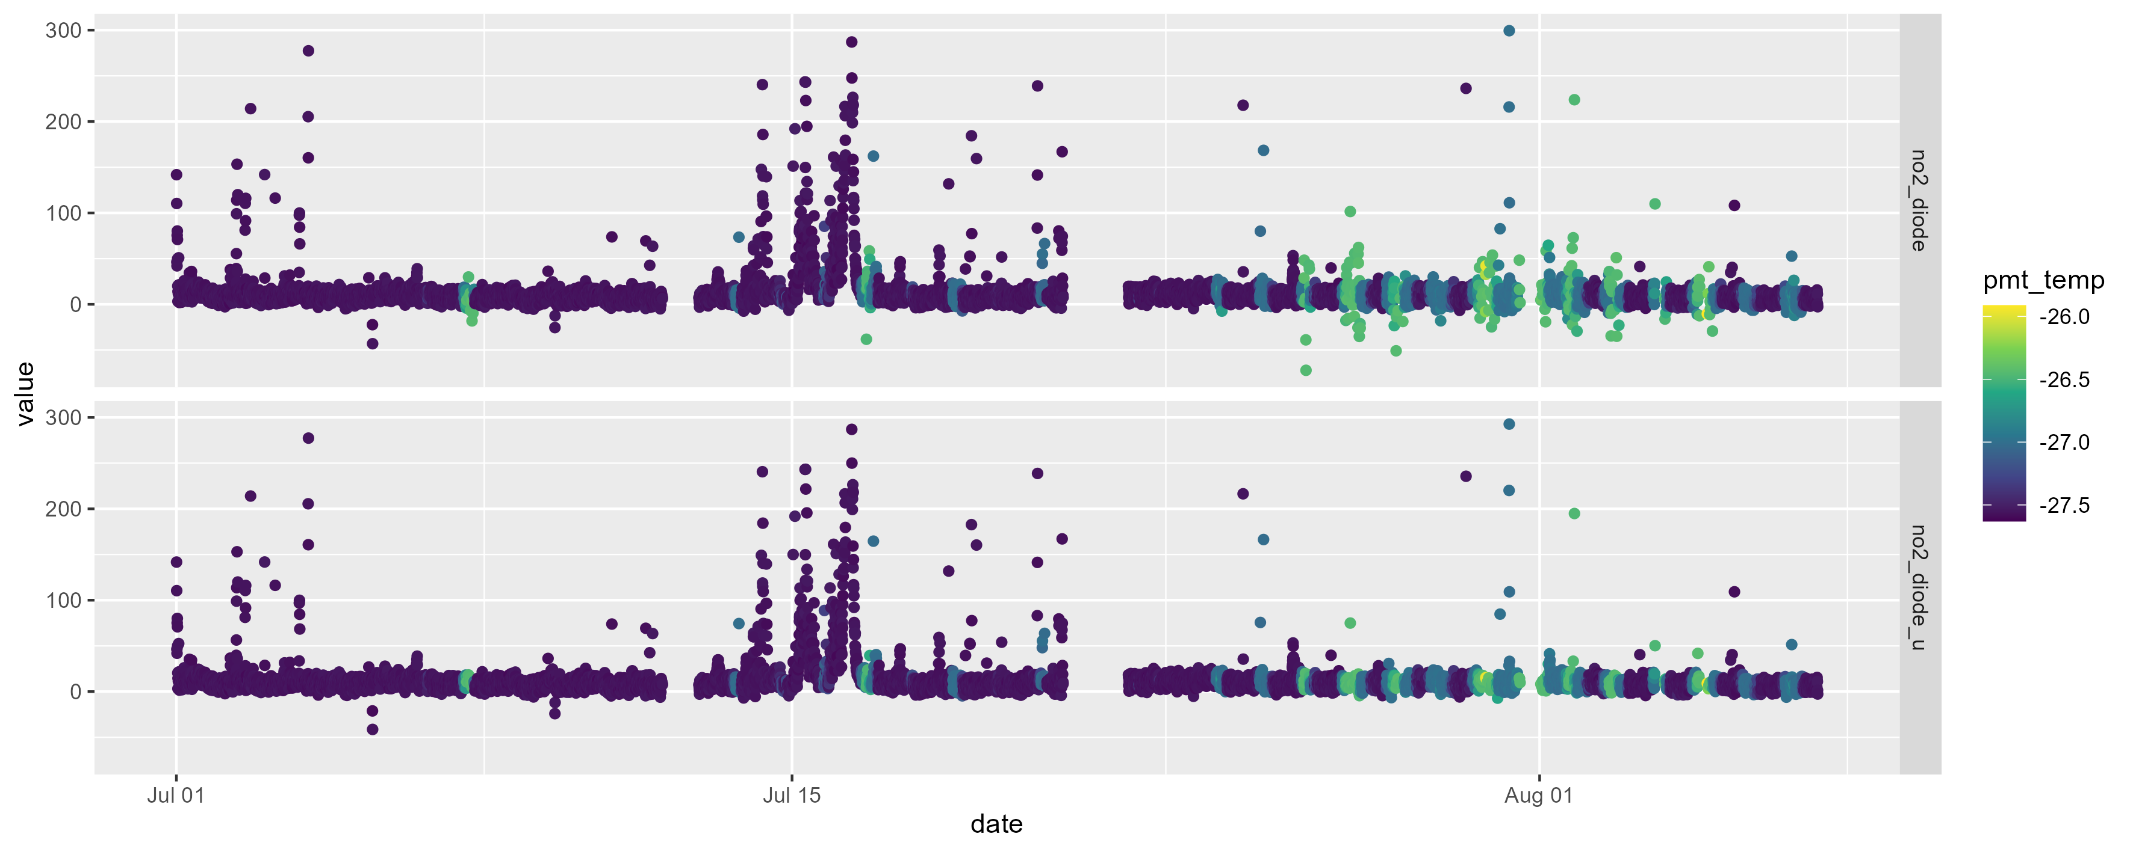
NO₂ diode in July and early August

Slide 8
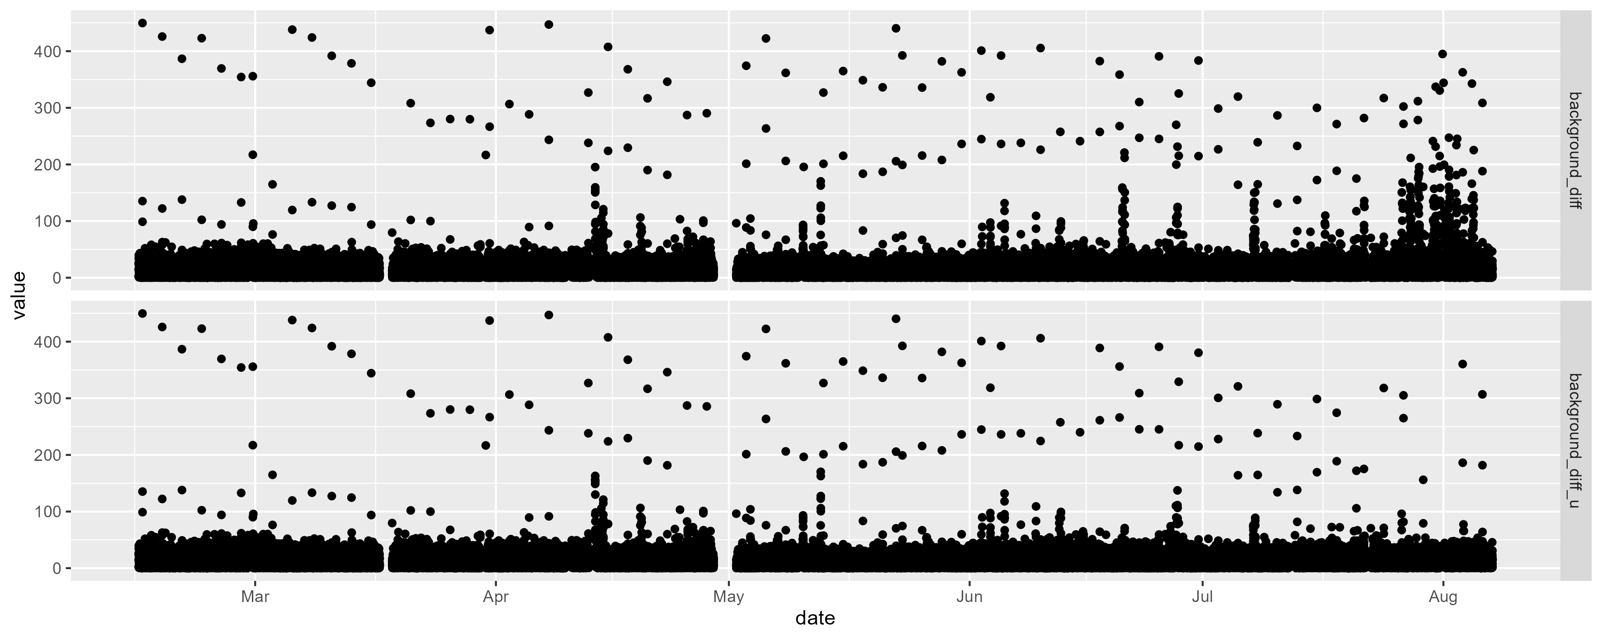
Difference between background plots
Notes:
Filtered so the difference is below 450
Checking to see if the difference between subsequent background measurements has stayed pretty much constant with the temperature issues -> looks like it has
Can see that in late July/August the difference is larger for the data that was processed with code that filtered out instances when the PMT temperature was above -28 degrees

